Slide 1




Slide 2


Overview
Name of the Body Except Body
Avg.Aspect Ratio
Mesh Quality
Measures:
Area
Avg. Skewness
Volume
Approximate Thickness
Categories
Industries
Euler's characteristic
Topology Information
LabelEncoder()
Normalized between 0-1
GWU Immanual R Sri Ramakrishna Institute of Technology

Slide 3
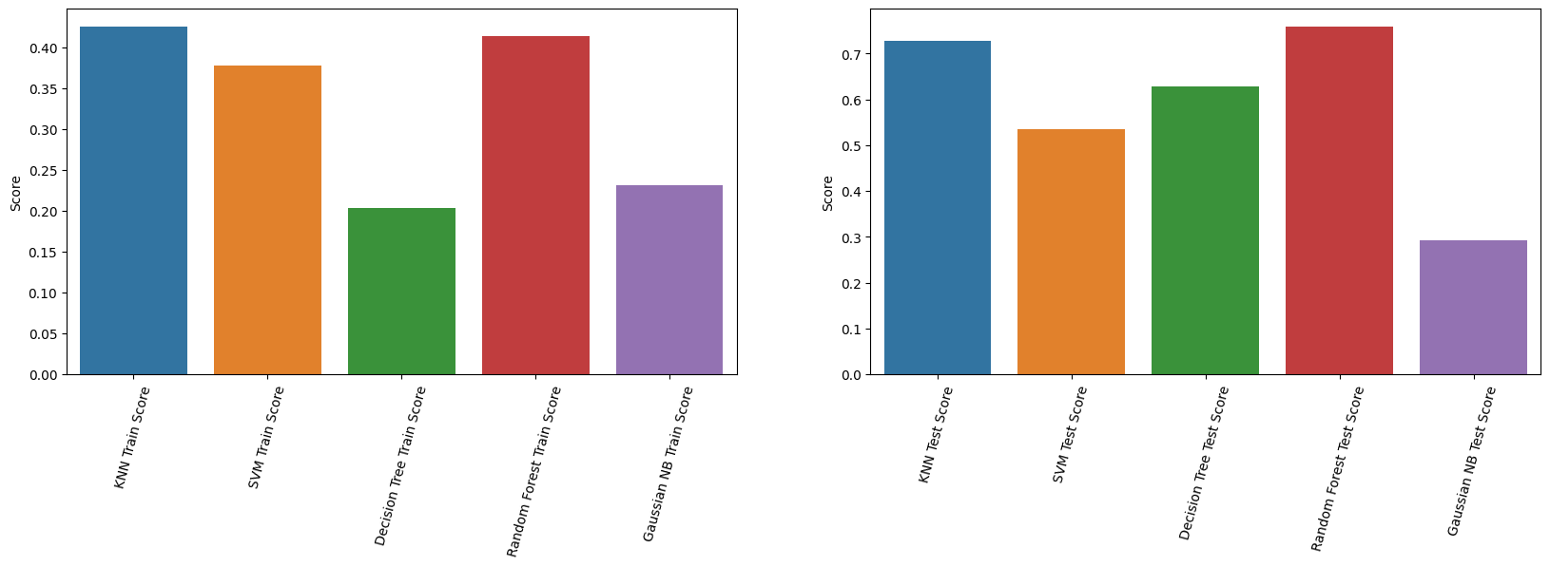
Overview
Logistic Regression
KNN Classifier
Support Vector Classifier
INPUT PARAMETERS
Decision Tree Classifier
Random Forest Classifier
Naïve Bayes Classifier
Readiness
immangwu/GWU
Output PARAMETERS
Feasibility Metric
GWU Immanual R Sri Ramakrishna Institute of Technology

Slide 4
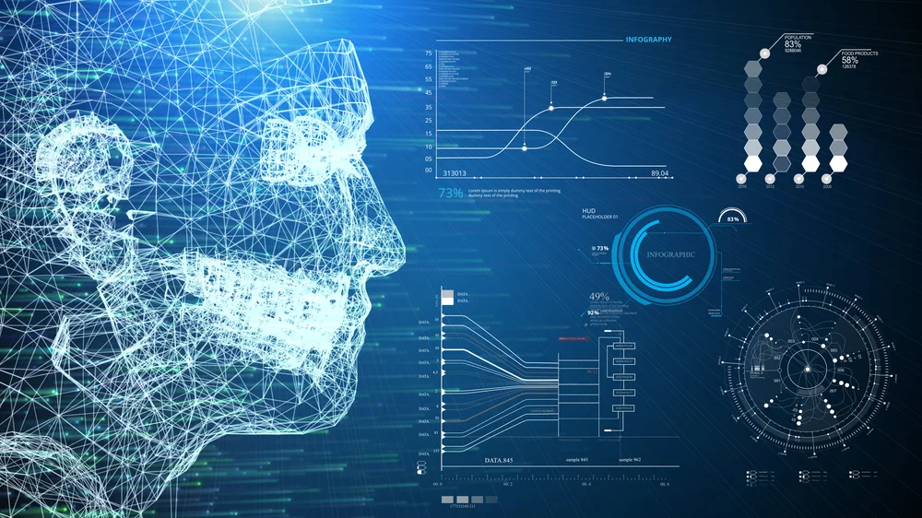
Future Direction
Team work : Zhenghui Sha
Language Model
Volume
OBJ File
Prompt to get cost of the body
Industry
Impact of the Idea
Topology Feature
Connectivity
Categories
Image with CNN
Curvature Features
Assembly
Component
Body
Mesh Simplification Metrics
More Inputs
GWU Immanual R Sri Ramakrishna Institute of Technology

